Slide 1



Development of a Test Facility for Studies Relevant to Replacing Dangerous Radiological Sources Long Vo
Aaron Hellinger, Maria Pinilla, William Dunn, Walter McNeil, Amir Bahadori
Department of Mechanical and Nuclear Engineering
Kansas State University
Manhattan, KS 66506 USA

Slide 2
Preview
Motivation
Facility overview
Benchmarking tool
Design
D-T Generator
Test facility
Location
Design
Operation
Representative test results
Summary

Slide 3
Motivation
The KSU Materials Interrogation (KSUMI) Test Facility
Replacement of Dangerous Radiological Sources (RDRS) – Current focus
Detection and identification of Special Nuclear Materials (SNM)
Radionuclide detection and identification in variable-background environments
RDRS is concerned with well logging tool:
widely distributed to remote areas around the world
contain multi-Ci neutron and gamma- ray sources such as ²⁴¹Am-Be and ¹³⁷Cs.
Source: U.S. Geological Survey, February 2018

Slide 4
NAS Study
The National Academy of Sciences (NAS) commissioned a study soon after 9/11/2001 to consider the dangers of large radiological sources
Radionuclide | Half-life (yr) | Particles-Energies (MeV) | Principal Applications | US Inventory (Ci)
Cs-137 | 30.17 | β-0.518 max; β-1.18 max; γ-0.662 | Industrial gauging, Irradiators, Well logging | 2,800,000
Co-60 | 5.27 | γ-1.173; γ-1.333 | Sterilization, Irradiators, Teletherapy | 198,000,000
Am-241 | 432.2 | α-5.64; γ-0.060 | Well logging, Gauging | 6,482
Pu-238 | 87.7 | α-5.59; γ-0.043 | RTGs | 937
Sr-90 | 28.9 | β-0.546 max | RTGs | 1,730,000
Se-75 | 119.8 d | γ-0.28 (ave), 0.8 max | Radiography | 261
Ir-192 | 74 d | β-1.46 max] γ-0.38 ave, 1.378 max | Radiography | 146,922
Cf-252 | 2.645 | α-6.22; n-2 ave; γ-various; fission products | Well logging Research | 7
Our focus on well logging is aimed at replacing ²⁴¹Am-Be sources, which emit both neutrons and high-energy gamma rays, and ¹³⁷Cs sources, which emit gamma rays and are usually in the form of water- soluble CsCl
We hope to show that a single deuterium-tritium (D-T) accelerator neutron source can replace both radioisotope sources
NAS findings

Slide 5
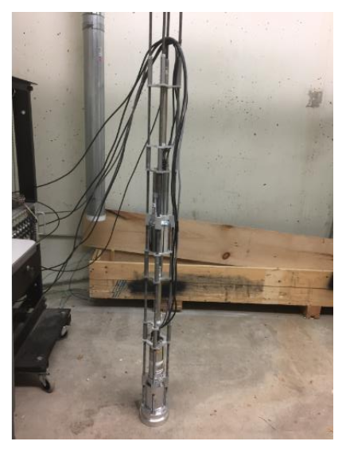
Benchmarking Tool Design
The benchmarking tool:
Skeleton
Sources
Shielding
Sensors
For the well-logging application:
²⁴¹Am-Be radioisotope and Thermo Fisher D-T generator
BF₃ and ³He neutron sensors
NaI(Tl) and CeBr₃ gamma sensors
Tool is used to benchmark Monte Carlo simulation results
Distances in inches, from target to centroid of active detection material
65.37’’
47.09’’
34.58’’
17.27’’
NaI(Tl)
Helium-3
NaI(Tl)
BF3
2’’ Lead
Accelerator’s Target
The Skeleton with only sensors

Slide 6
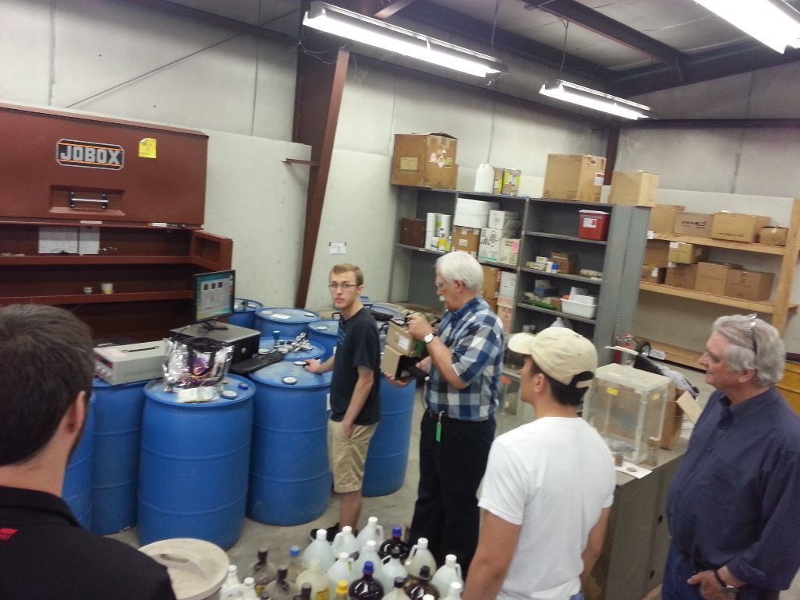
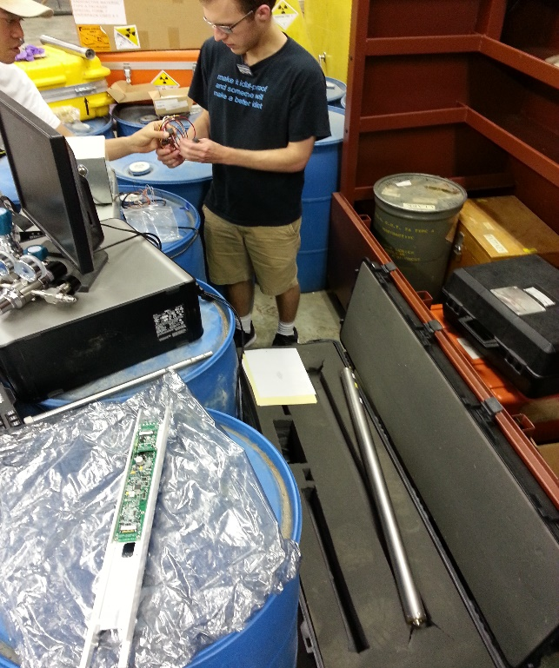
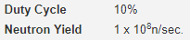
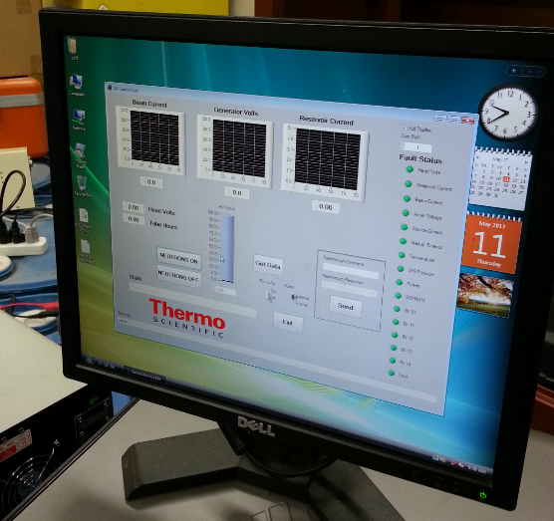
D-T Generator: Upon Arrival
Generator
Arrival-Test for defects at Safety Office’s facility
Making
Connections
Established Communication
B322 arrived with 1631DT accelerator tube and was in possession of safety officers. Arrival-tests were done at safety office’s facility:
Generator was filled to110 psi of 99.99% Sulfur Hexafluoride
200 Volts D.C.
Controlled via GUI by RS232 communication
Applications of the B322: oil & gas, mineral, environmental and imaging
Dimension: Cylindrical with 2 inches in diameter, 48 inches in length

Slide 7
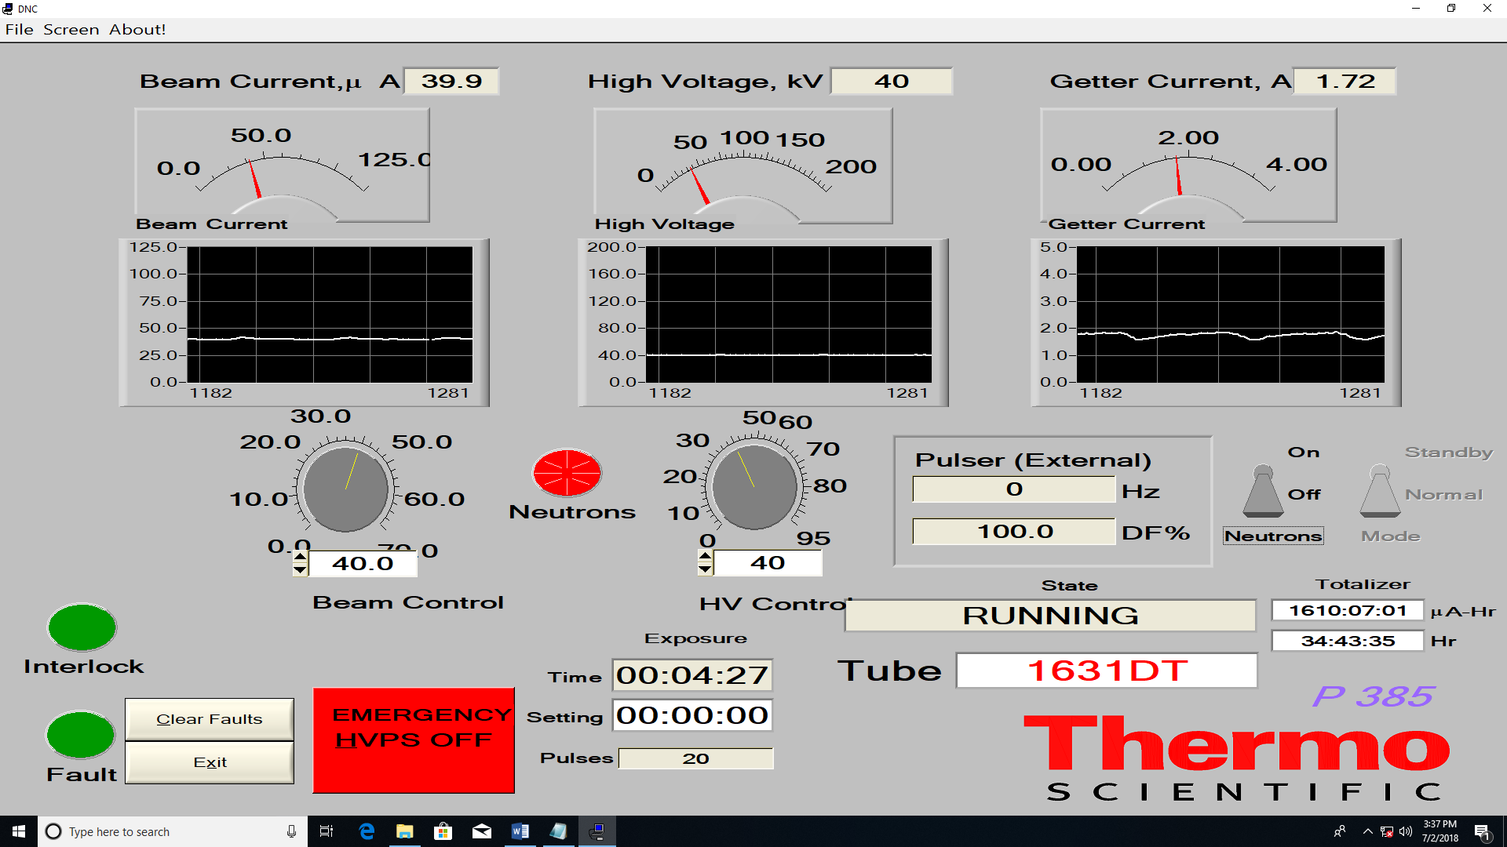
D-T Generator: GUI Controller
Interlock enabled GUI
80 kV, 60 uA = 1.6 x 10⁸ nps determined by Copper activation
1 kHz 10% Duty Cycle
~45 seconds to the first neutron produced
~55 seconds to full power neutron production
GUI CONTROLLER

Slide 8

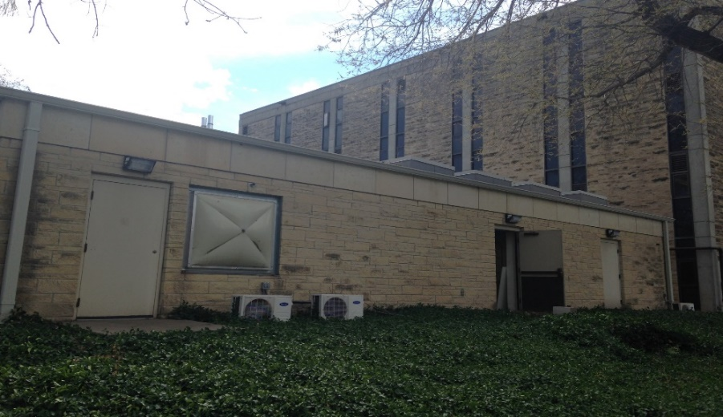
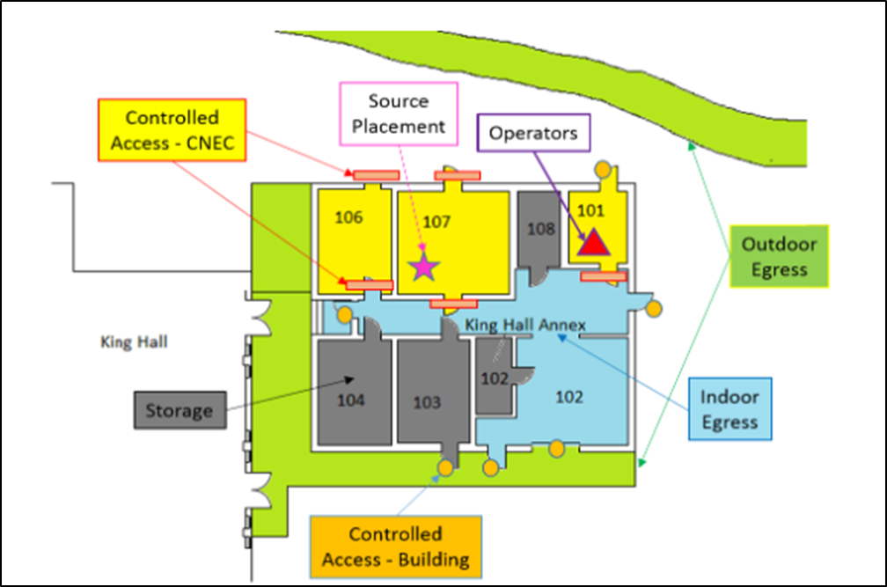
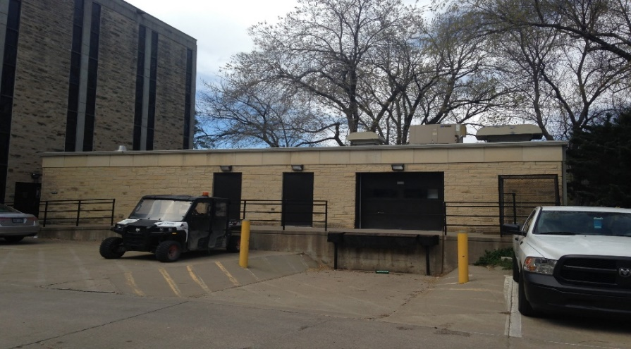
Test Facility: Location
The KSUMI Test Facility is at King Hall Annex at KSU
N
Room 101
Room 107
North Side View
Facility Floor Plan
South Side View

Slide 9
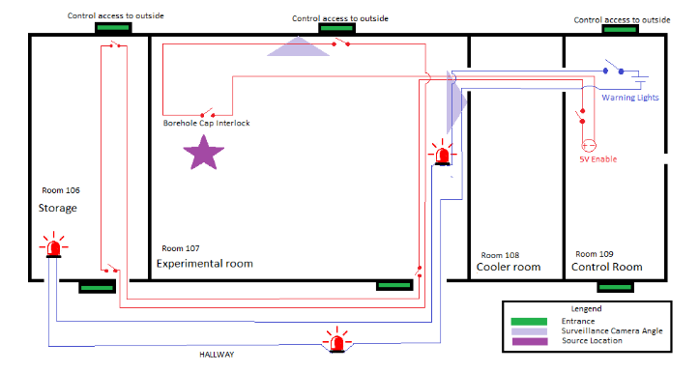
Test Facility: Accelerator Enabling and Safeguard Systems
N
Accelerator Enabling System prevents inadvertent neutron production and entries
Other Safeguards include:
Surveillance
Intercommunication
Warning lights
Procedures
Low dosage for bystanders and workers. Only workers who enters experiment room requires dosimeters.
Source
Storage
Experimental Room
Control Station
Test Chamber
Cooler
Hallway
D-T generator’s Target
Video & Audio Surveillance
Controlled Access

Slide 10
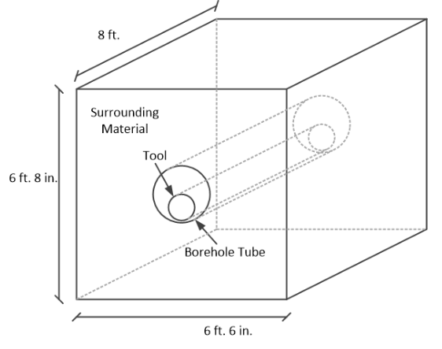
Test Facility: Test Chamber Design
The test chamber is 6’-8” high by 6’-6” wide by 8’ deep
Volume inside the chamber is ~2,500 gal
When filled with water, the chamber presents an effectively infinite medium to the D-T neutrons
Tool goes inside the borehole tube which is surrounded by a medium such as air, water, sand, or limestone chips.
Test Chamber dimensions

Slide 11
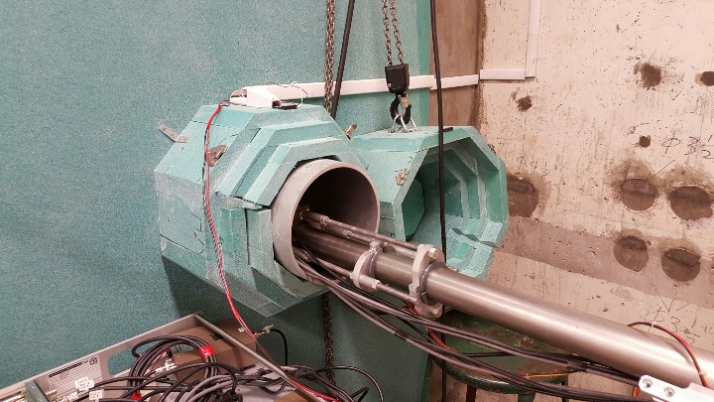
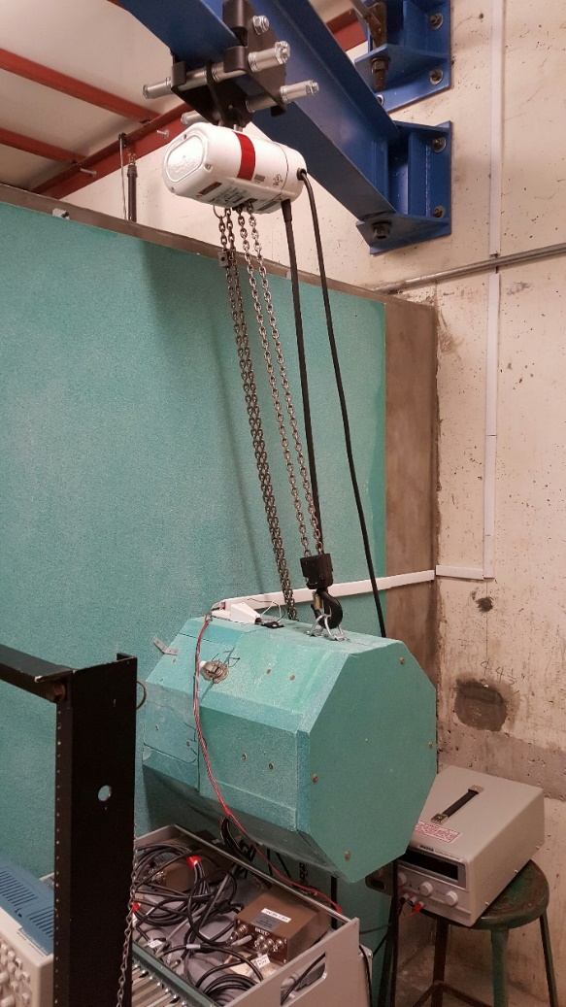
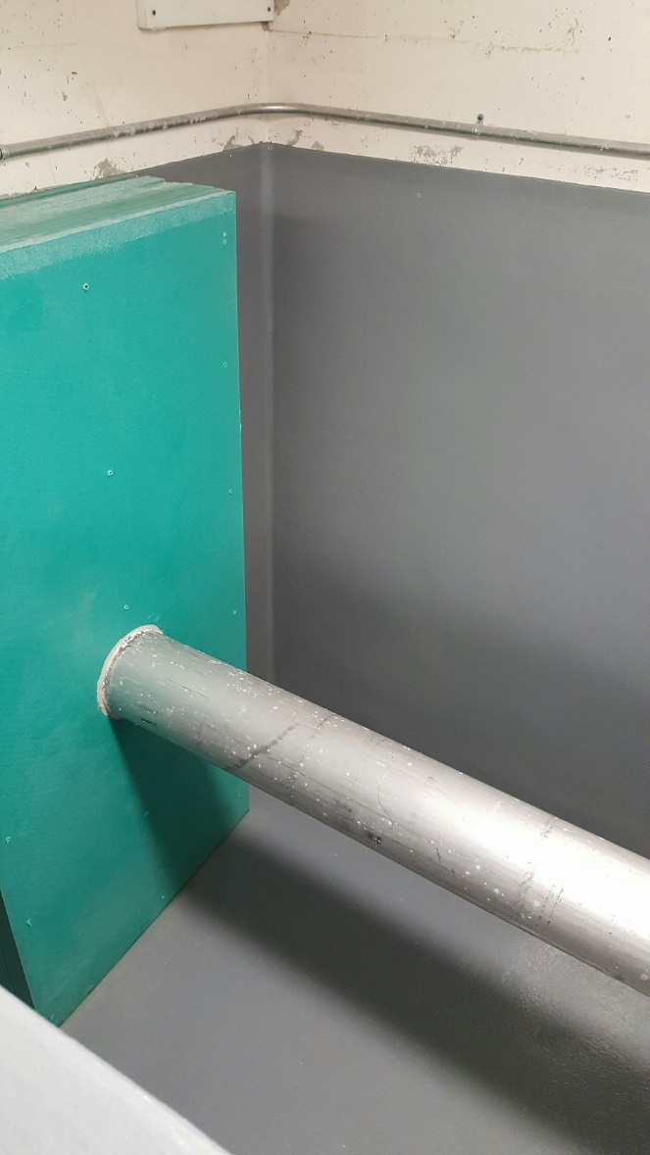
Test Facility: Test Chamber with Benchmark Tool
Shield Cap Interlock
Generator and tool inserting the chamber’s borehole tube
½ ton crane
Borehole tube
Open Borehole tube
Green objects are borated polyethylene
Test Chamber is currently outfitted to benchmark the logging tool
Ready for measurements
Inside The Chamber

Slide 12
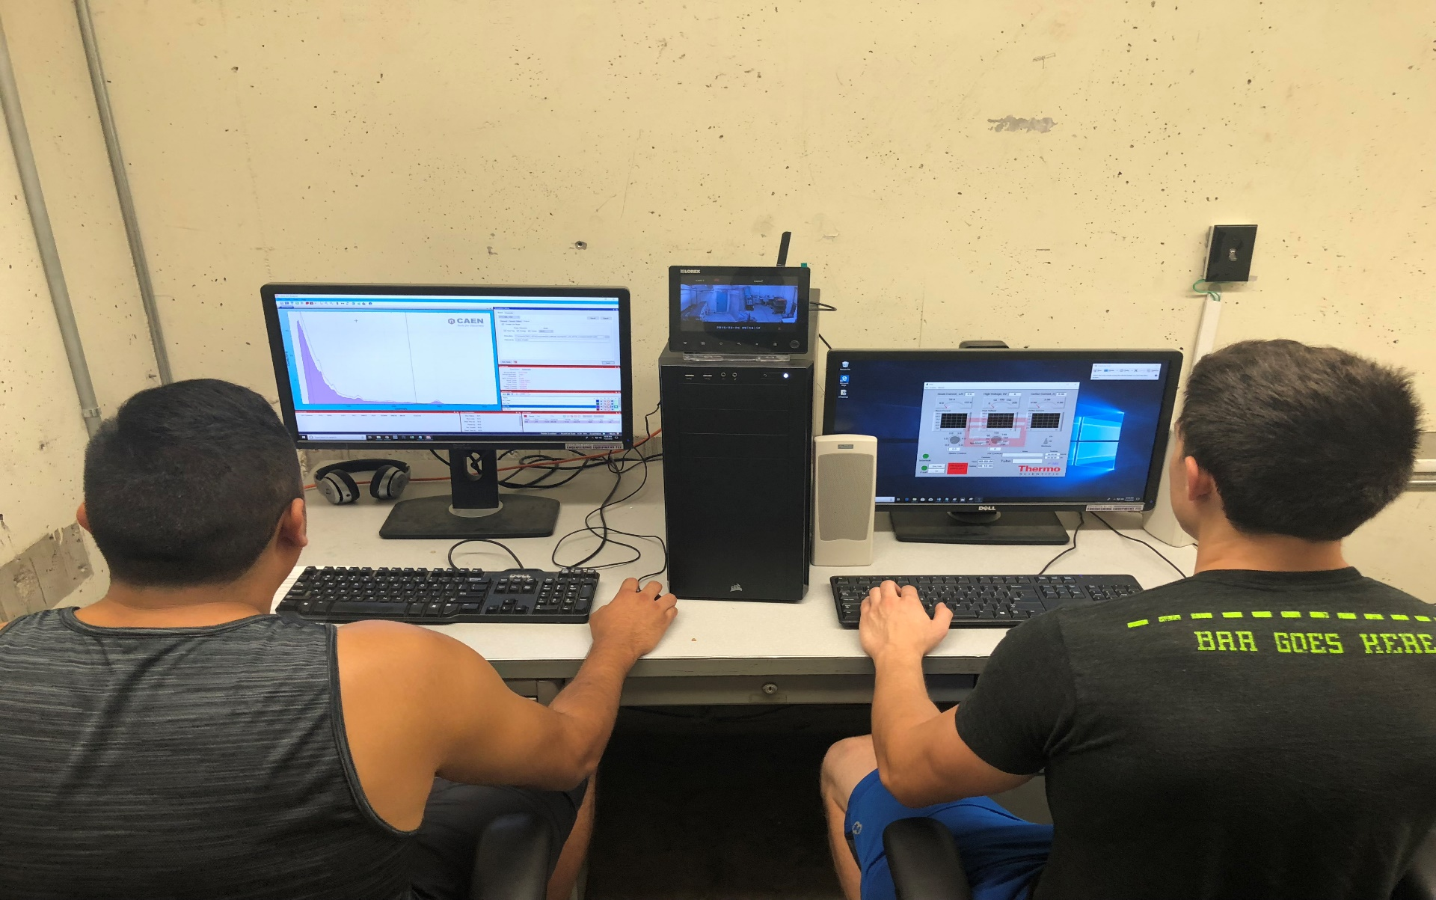
Test Facility: Control Room
Surveillance display and Intercommunication
D-T generator’s monitor and GUI control
Interlocks enabler
Measurements’ monitor and Control
Control Station

Slide 13
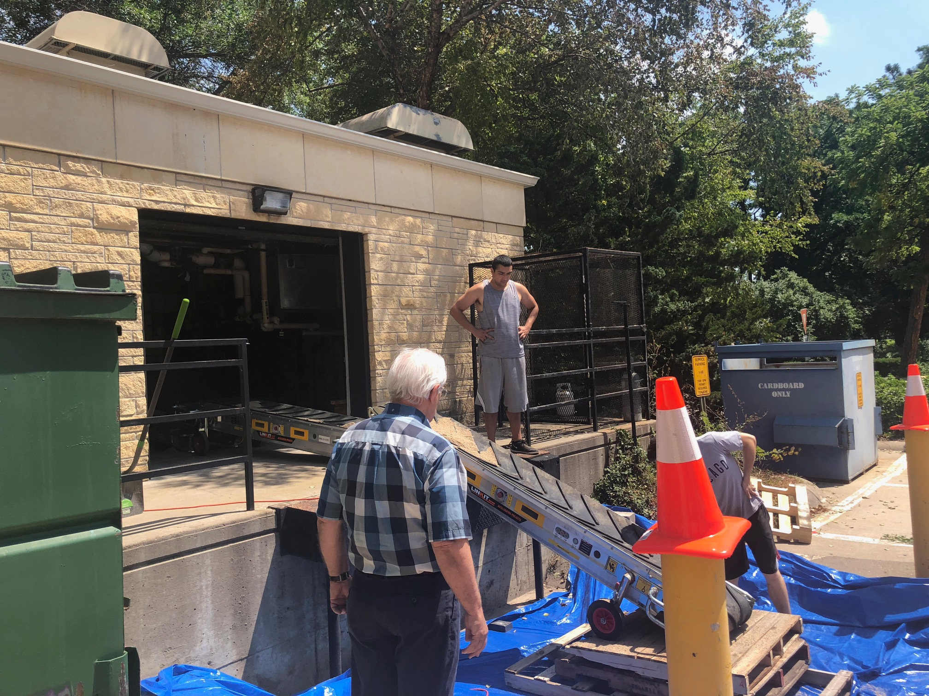
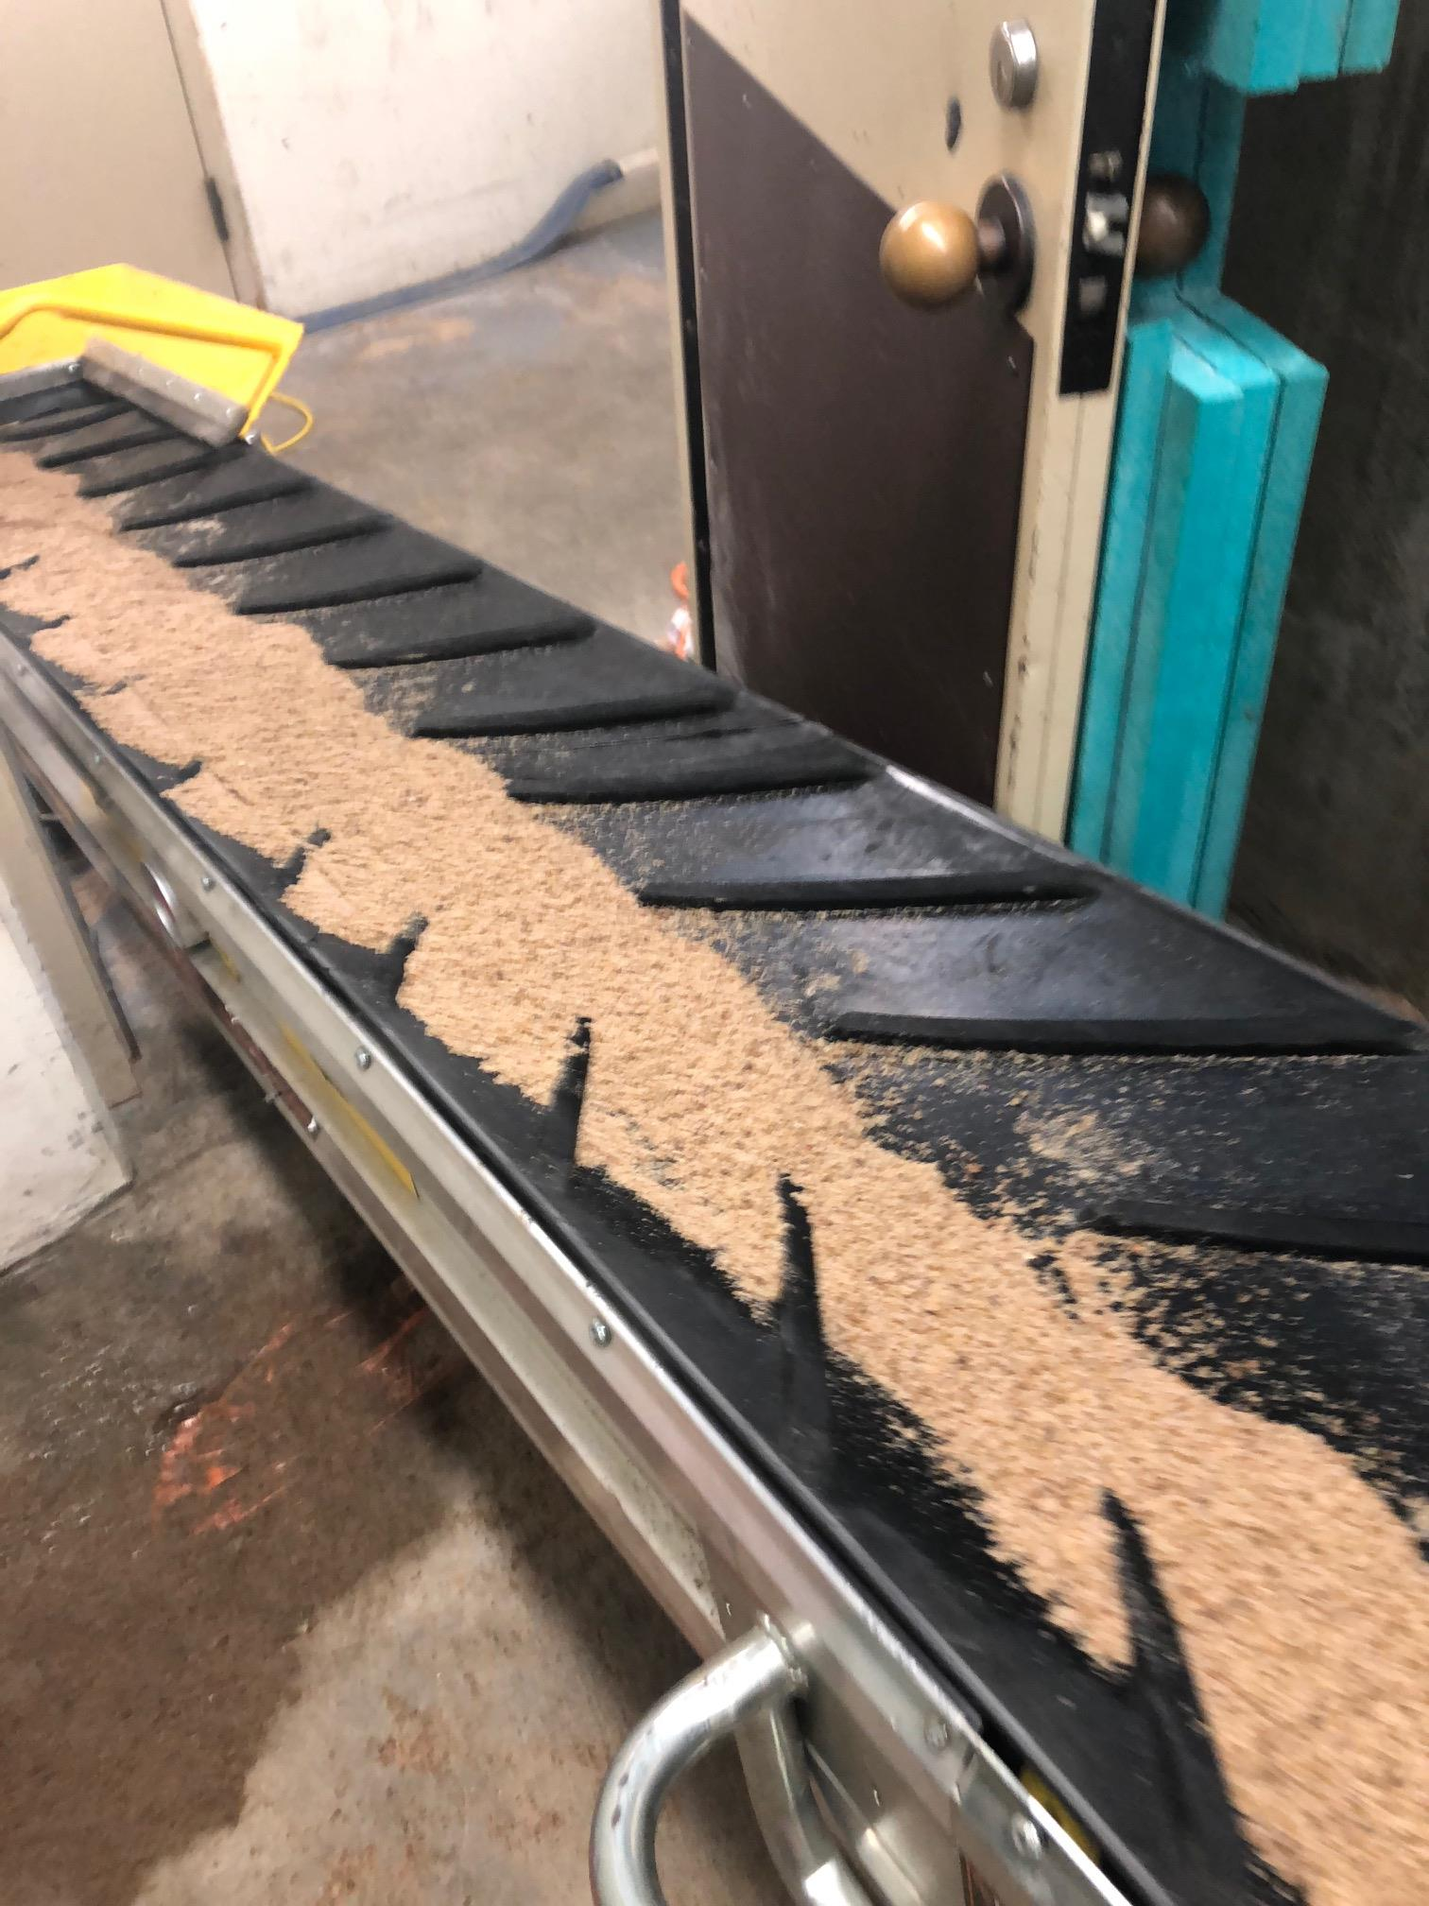
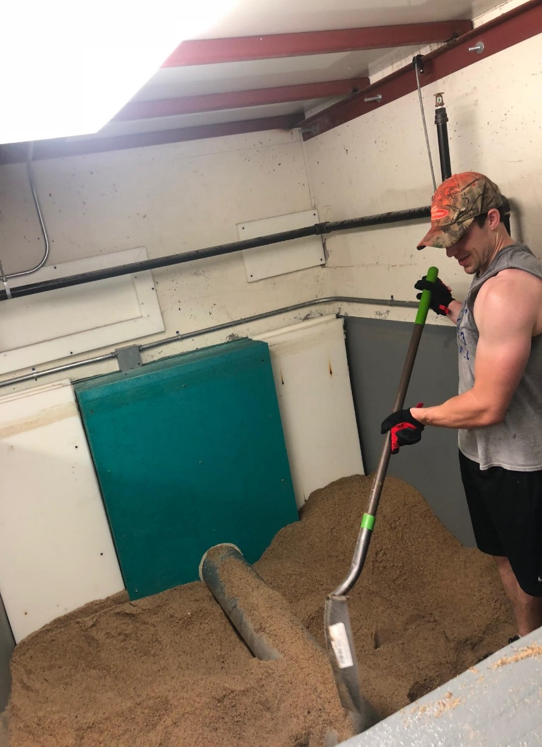
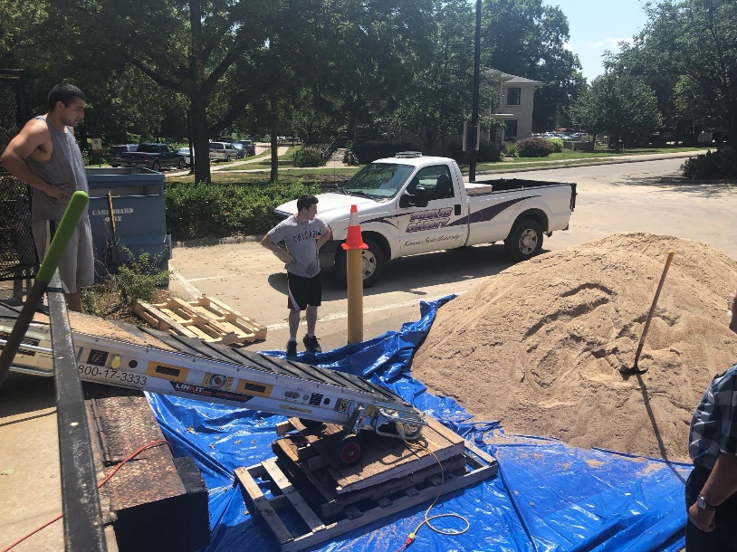
Test Facility: Material Loading
Conveyor Belt system for material movement
Safety Evaluation
Test Chamber material leveling

Slide 14
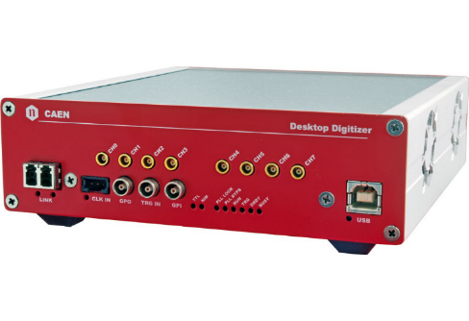
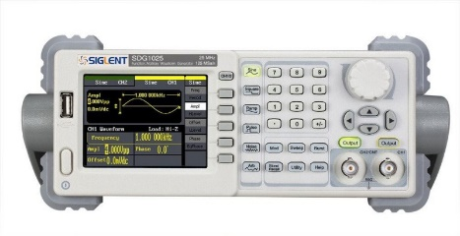
Test Facility: Data Acquisition Scheme
Physics
G-far
N-far
G-near
N-near
D-T Gen
Ch3
Ch2
Ch1
Ch0
Ch4
Ch1
Ch2
CAEN5730 Digitizer
Function generator
Fiber Optic
PC
Output text options:
List Mode in ASCII format
List Mode in binary format
Data Acquisition Scheme

Slide 15
Neutron–Nucleus interaction
Neutron-Nucleus Interaction
Scattering
Absorption
Transfer
Elastic
(n,n)
Inelastic
(n,n’)
Capture
(n,γ)
fission
(n,f)
(n,2n)
(n,α)
(n,p)

Slide 16
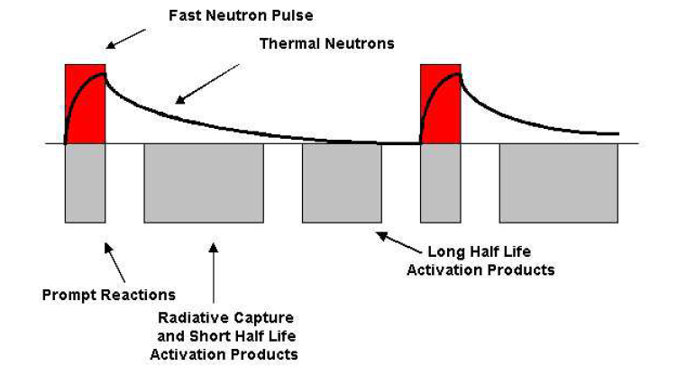
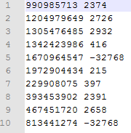
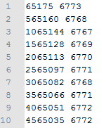
Representative Test Results: Water Sample
Events list
Triggers list
Expected Physics
Expected Physics: Die-away
Observed reactions
Observed prompt and delay gammas

Slide 17
Potential Applications
The KSUMI test facility can be used to benchmark simulation models for oil well logging tools
We can conduct active interrogation with sources such as the D-T accelerator source or radioisotope sources such as ²⁴¹Am-Be and ¹³⁷Cs
We can also do passive interrogation by removing all sources from the tool
We can substitute other detectors, e.g. CeBr₃ scintillation sensor and hand-held HPGe solid state sensor for remote source detection and possible identification

Slide 18
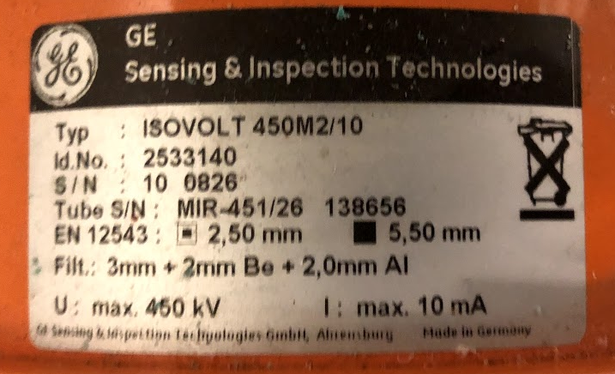
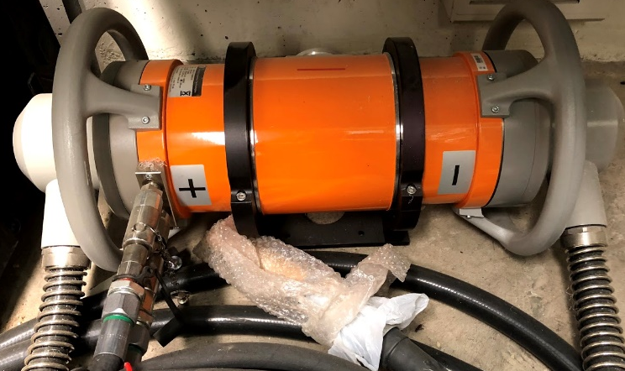
ISOVOLT
Industrial X-ray Generator, 450 kV max
System constituents:
X-ray Tube and Control Module
Cooling Unit
Digital Radiography flat panel imaging system
Currently configured for multiphase flow imaging
Operational constraint of 150 kV to limit human exposure

Slide 19
Summary
The KSUMI capabilities: RDRS, detection of SNM, and source and material characterization studies
Full-scale test chamber and tool with variable sources, sensors, and shielding
So far, we have used both ²⁴¹Am-Be and D-T sources, BF₃ and ³He neutron detectors, and NaI(Tl) and CeBr₃ photon detectors
Preliminary MCNP simulation models have been shown to agree with experimental results, which allows us to use the test facility as a benchmark and the simulation models to study materials and detectors that are difficult or expensive to use experimentally
This work is sponsored by NNSA through the Consortium for Nonproliferation Enabling Capabilities (CNEC)

Slide 20
References
Bob Burkhart, “Neutron Generator and Well Logging”, Sandia National Laboratories, SAND2006-3291C, www.osti.gov/servlets/purl/1264595
Committee on Radiation Source and Replacement, 2008, Radiation Source Use and Replacement, National Research Council, ISBN 0-309-110115-7, National Academies Press, Washington, DC (NAS-2008)
Gardner, et al., 2013, ANS Panel on “Recent Developments in Radiation Source Use and Replacement after the NAS Report of 2008”, Transactions of the American Nuclear Society, Vol. 109, 47.
Liberman, A.D et. al., “A method to determine the absolute neutron output of small D-T generator”, Nuclear Instruments and Methods in Physics Research Section B, Volume 79, Issue 1-4, p. 574-578, June 1993
Preston R.M. et al, “Neutron generator burst timing measured using a pulse shape discrimination plastic scintillator with silicon photomultiplier readout”, Journal of Instrumentation, December 8, 2013
U.S. Total Crude Oil and Petroleum Products, U.S. Geological Survey, www.usgs.gov, accessed February 2018

Slide 21
Thank you for your attention. Questions?
LONG VO
Email: Longv@ksu.edu

